Slide 1
Week 3: Healthcare Supply
HPM 6503
Spring 2026
Nada Boualam, PhD

Slide 2
Week 3: Outline
Announcements
Last week review
Firms & profit
Supply curve & supply shifters
Elasticity

Slide 3
Announcements
Accommodations for Exam 1
  Exam 1 will be from 6pm-8:20pm
  Exam 1 will be a 2 hour exam
  Office of ODS will reach out to students with registered accommodations to schedule their exam, most likely 5:30pm-9pm on the 18th
  No other accommodations will be granted
  Exam will be set up on canvas
  Review sessions will be announced next week
Attendance & Participation grade
Guest speaker confirmed!

Slide 4
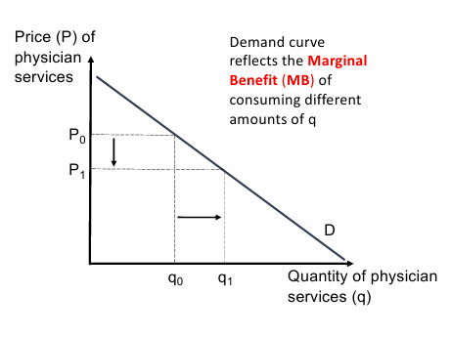
Last Week Recap: Demand Curve for Physician Services
Utility & preferences
Demand for health vs. health care
Health stock as a production and as a resource
Marginal Benefit of consuming different amount of medical care
Elasticity of demand
Notes:
Changes in price → movement along the curve
Other changes → movement of the curve

Slide 5
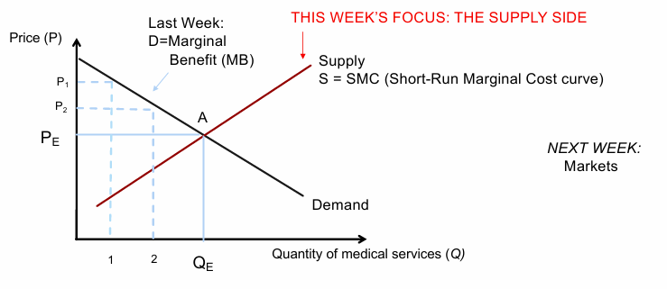
Today’s Focus: Medical Care Production & Costs

Slide 6
But first, let’s back up: Firms maximize profit
For profit firms have one goal above all else: maximize profit

Slide 7
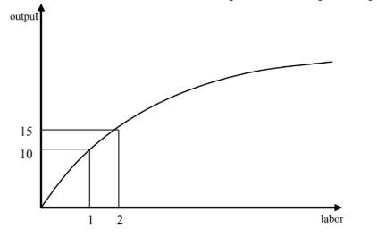
Production Function
Little control over price or cost → Firms mostly control output quantity q
Production function relates quantities of input (e.g. labor, capital) to quantity of output (e.g. medical services)

Slide 8

Production Function
Diminishing returns of labor → MP of labor is decreasing

Slide 9
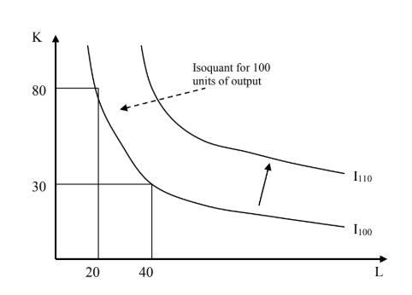
Isoquant
Definition
Isoquant: specifies various input combinations needed to produce a given level of output
Notes:
This is the production equivalent of indifference curve

Slide 10
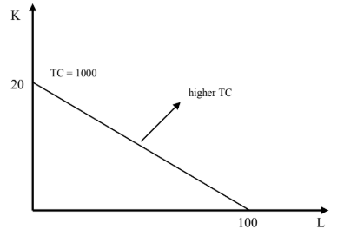

Isocost
Definition
Isocost: relates all the combinations of inputs that cost a given amount
Notes:
This is the production equivalent of the budget constraint

Slide 11
How do firms maximize profit (graphically)?

Slide 12
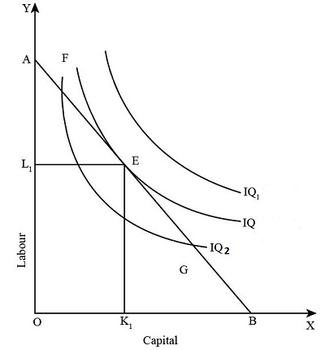
How do firms maximize profit (graphically)?
Notes:
→ Given a budget constraint (isocost curve), we maximize output (shift the isoquant until it is tangent)
Draw on the board!!!!!!! Budget constraint and isoquant until it is tangent

Slide 13
Firms maximize profit
Firms’ objectives:
Maximize revenue
Minimize costs: for each output level q, the firm chooses the lowest‑cost isocost that still touches the isoquant for that output quantity q.
  Minimum costs for each isoquants builds the cost function C(q)
Notes:
→ Given a budget constraint (isocost curve), we maximize output (shift the isoquant until it is tangent)
Draw on the board!!!!!!! Budget constraint and isoquant until it is tangent

Slide 14
Fixed vs. Variable Costs
In the short run, 2 types of costs: Fixed and Variable
Fixed costs do not depend on the output of the firm. Physician has an office, rented for 5k/month. That cost does not vary based on the number of patients they see. Same with equipment, like MRI scanner, which costs ~2m regardless of 20 vs. 2000 patients.
Variable costs vary with output. Each patient you see you need a tongue depressor, needles for blood, electricity to administer tests. Labor can also be a variable cost, as more staff may be needed as number of patients grow.

Slide 15
Fixed vs. Variable Costs
Short run vs. Long Run
Some things are fixed in the short run but constraints can be addressed in the long run → In the long run, all costs are variable
Definition
The short run is the period in time in which the level of at least one input cannot be changed
Notes:
Negative relationship between productivity & costs
If productivity of an input (a worker’s hour) goes up (e.g. worker works faster) the cost of producing a good goes down.
Average vs Marginal Productivity
If marginal productivity of next worker hired is greater than the average productivity of existing workers, then it pulls the average productivity up.

Slide 16
Some relevant concepts
Negative relationship between productivity & costs
If productivity of an input (a worker’s hour) goes up (worker works faster) the cost of producing a good goes down.
Average vs Marginal Productivity
If marginal productivity of next worker hired is greater than the average productivity of existing workers, then it pulls the average productivity up.
Short run vs. Long Run
Some things are fixed in the short run → constraints can be addressed in the long run
By definition, the short run is the period in time in which the level of at least one input cannot be changed

Slide 17
Average vs. Marginal Costs
Average costs = total costs/quantity produced = (fixed + variable costs) / quantity
Marginal costs = additional costs from producing the next unit of output. Fixed costs don’t affect marginal cost
MC = ΔTC/ΔQ = ΔVC/ΔQ

Slide 18
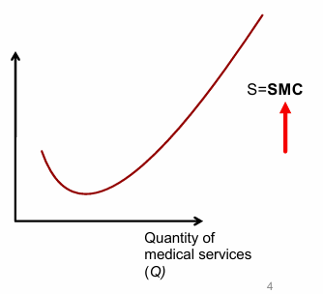

From Isocost to Supply Curve
Supply Curve represents the relationship between product price and quantity supplied
Notes:
Initial economies of scale (downward slope): As quantity increases from zero, marginal costs initially decrease due to fixed costs being spread over more units
Eventually rising costs (upward slope): After a certain point, capacity constraints, overtime, crowding, and diminishing returns cause marginal costs to increase
The key insight: Suppliers make production decisions based on marginal cost, so the supply curve literally is the marginal cost curve (specifically, the upward-sloping portion where MC is above average variable cost).

Slide 19

From Isocost to Supply Curve
Supply Curve is actually the Short-Run Marginal Cost Curve
Notes:
Initial economies of scale (downward slope): As quantity increases from zero, marginal costs initially decrease due to fixed costs being spread over more units
Eventually rising costs (upward slope): After a certain point, capacity constraints, overtime, crowding, and diminishing returns cause marginal costs to increase
The key insight: Suppliers make production decisions based on marginal cost, so the supply curve literally is the marginal cost curve (specifically, the upward-sloping portion where MC is above average variable cost).

Slide 20
From Isocost to Supply Curve
Supply Curve is actually the Short-Run Marginal Cost Curve (SMC)
Capacity constraint, diminishing returns
Economies of scale
Notes:
Initial economies of scale (downward slope): As quantity increases from zero, marginal costs initially decrease due to fixed costs being spread over more units
Eventually rising costs (upward slope): After a certain point, capacity constraints, overtime, crowding, and diminishing returns cause marginal costs to increase
The key insight: Suppliers make production decisions based on marginal cost, so the supply curve literally is the marginal cost curve (specifically, the upward-sloping portion where MC is above average variable cost).

Slide 21
Costs & Productivity
The relationship between productivity & costs is negative
If productivity of an input (a worker’s hour) goes up (worker works faster) the cost of producing a good goes down.
Production Function: identifies different ways the inputs can be combined to produce different levels of outputs

Slide 22
Production Function
Diminishing returns of labor → MP of labor is decreasing

Slide 23

Attendance

Slide 24
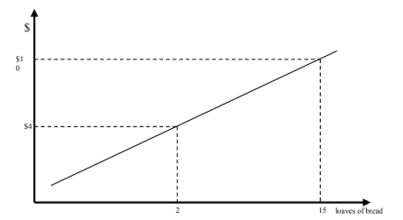
Supply Curve
Supply: relationship between quantity supplied and product price (ceteris paribus

Slide 25
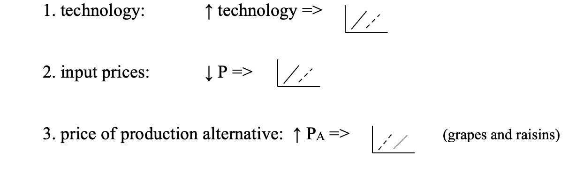
Supply Shifters

Slide 26
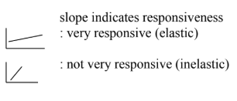
Supply Curve
Slope indicates elasticity of supply

Slide 27
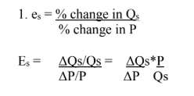
Elasticity of supply
Notes:
Es always positive,
If over 1, elastic if not not elastic

Slide 28

Break

Slide 29
SR Production Function of a Medical Firm - Assumptions
Medical firm produces a single output of medical services q
Only two medical inputs: nurse-hours n (labor) & composite capital good k
Quantity of capital is fixed at some amount
Production Efficiency: Medical firm faces an incentive to produce as efficiently as possible
Medical firm possesses perfect information regarding the demand for its product

Slide 30
Short Run Production Function of a Medical Firm
The Production Function:
Identifies different ways nurse-hours & capital can be combined to produce various levels of medical services
Different levels of output produced by
  Different combinations of the nursing and capital inputs
  Each combination assumed to be technically efficient (i.e. maximum amount of output q is produced given the state of technology)

Slide 31
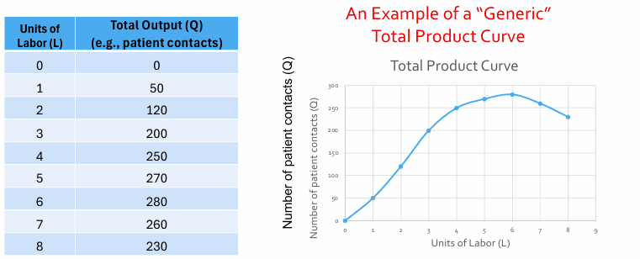
Short Run Production Function of a Medical Firm
Notes:
The total product curve shows that output initially increases at an increasing rate from 0 to n3, then increases at a decreasing rate from n3 to n6 nurse-hours, and finally declines after n6 nurse-hours as the medical firm employs more nurse-hours. Diminishing marginal productivity is the reason why output fails to expand at an increasing rate after n

Slide 32
Short Run Production Function of a Medical Firm
Total Product Curve: Depicts total output produced by different levels of the variable input, holding all other inputs constant
Law of diminishing marginal productivity:
At first, total output increases at an increasing rate
After some point, it increases at a decreasing rate
And then it will begin to decrease

Slide 33
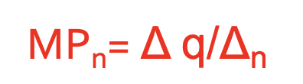
Marginal Product
Definition:
Change in total output associated with a one-unit change in the variable input
Magnitude of the marginal product of a nurse-hour reveals the additional quantity of medical services produced by each additional nurse-hour
Initially, increasing marginal productivity, but eventually diminishing marginal productivity

Slide 34
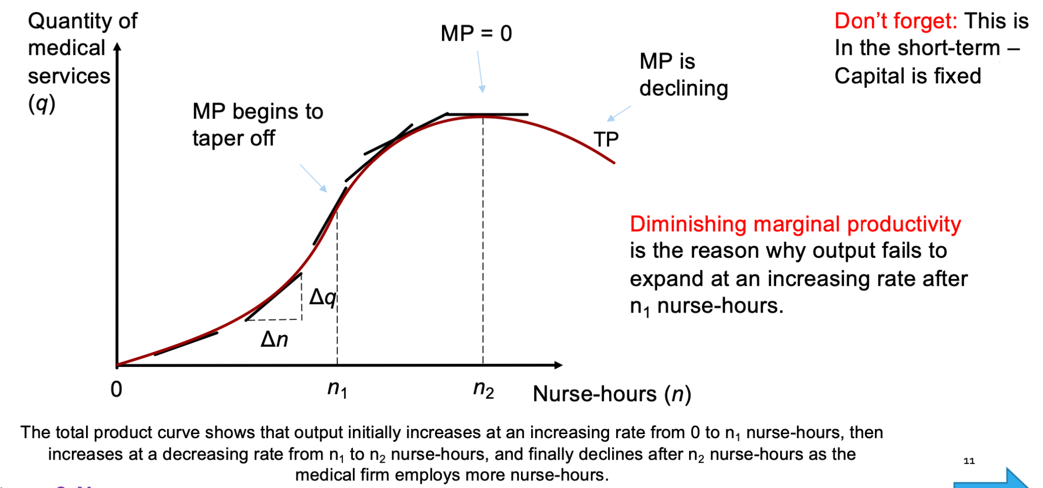
Marginal Product

Slide 35
Average Product
Average product, APn = Total quantity of medical services divided by the total number of nurse-hours
APn = q/n
Initially increases, then reaches a maximum, then decreases due to diminishing marginal productivity

Slide 36
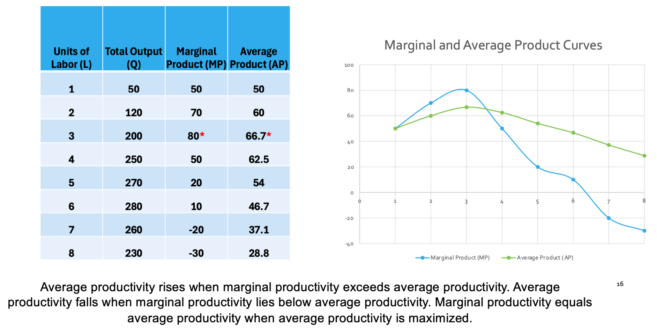
Marginal vs. Average Product
Notes:
At some point in the production process, the additional nurse
becomes less productive due to the constraint imposed by the fixed
input
• If MP is above AP, AP is increasing [MP is pulling AP up]
• MP curve cuts AP curve at the AP curve’s maximum point
• If MP is below AP, AP is declining [MP is pulling AP down]

Slide 37
Marginal vs. Average Product
Notes:
At some point in the production process, the additional nurse
becomes less productive due to the constraint imposed by the fixed
input
• If MP is above AP, AP is increasing [MP is pulling AP up]
• MP curve cuts AP curve at the AP curve’s maximum point
• If MP is below AP, AP is declining [MP is pulling AP down]

Slide 38
Back to Costs
Total costs = Explicit Costs + Implicit Costs
Explicit Costs = salaries, utility bills, supplies
Implicit Costs = opportunity cost of the resources (e.g. rental price of MRI)

Slide 39
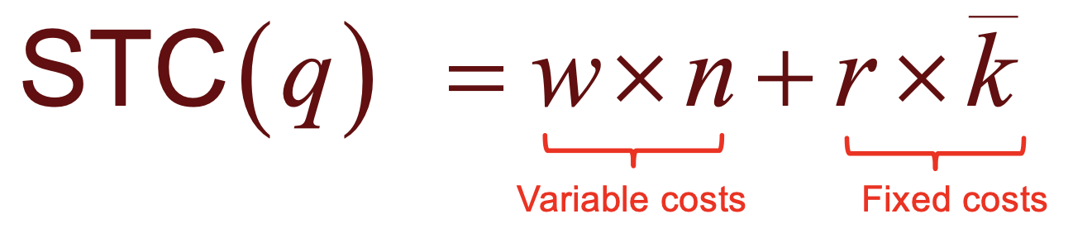
Back to Cost: Short Run Total Cost Function
• Level of medical output: q
• Variable input nurse-hours: n
• w = hourly wage for a nurse
• Fixed input capital: k
• r = “rental” or opportunity cost of capital
• Input prices - Assumed fixed

Slide 40
Short Run Total Cost = SR Variable Cost + SR Fixed Cost
1. Total variable cost of production, STVC
In this example, STVC=Total worker wage bill = Wage rate * the number of nurse-hours
Responds to changes in the level of output
2. Total fixed costs of production, STFC
In this example, STFC=Rental price * the quantity of capital
Does NOT respond to changes in output

Slide 41
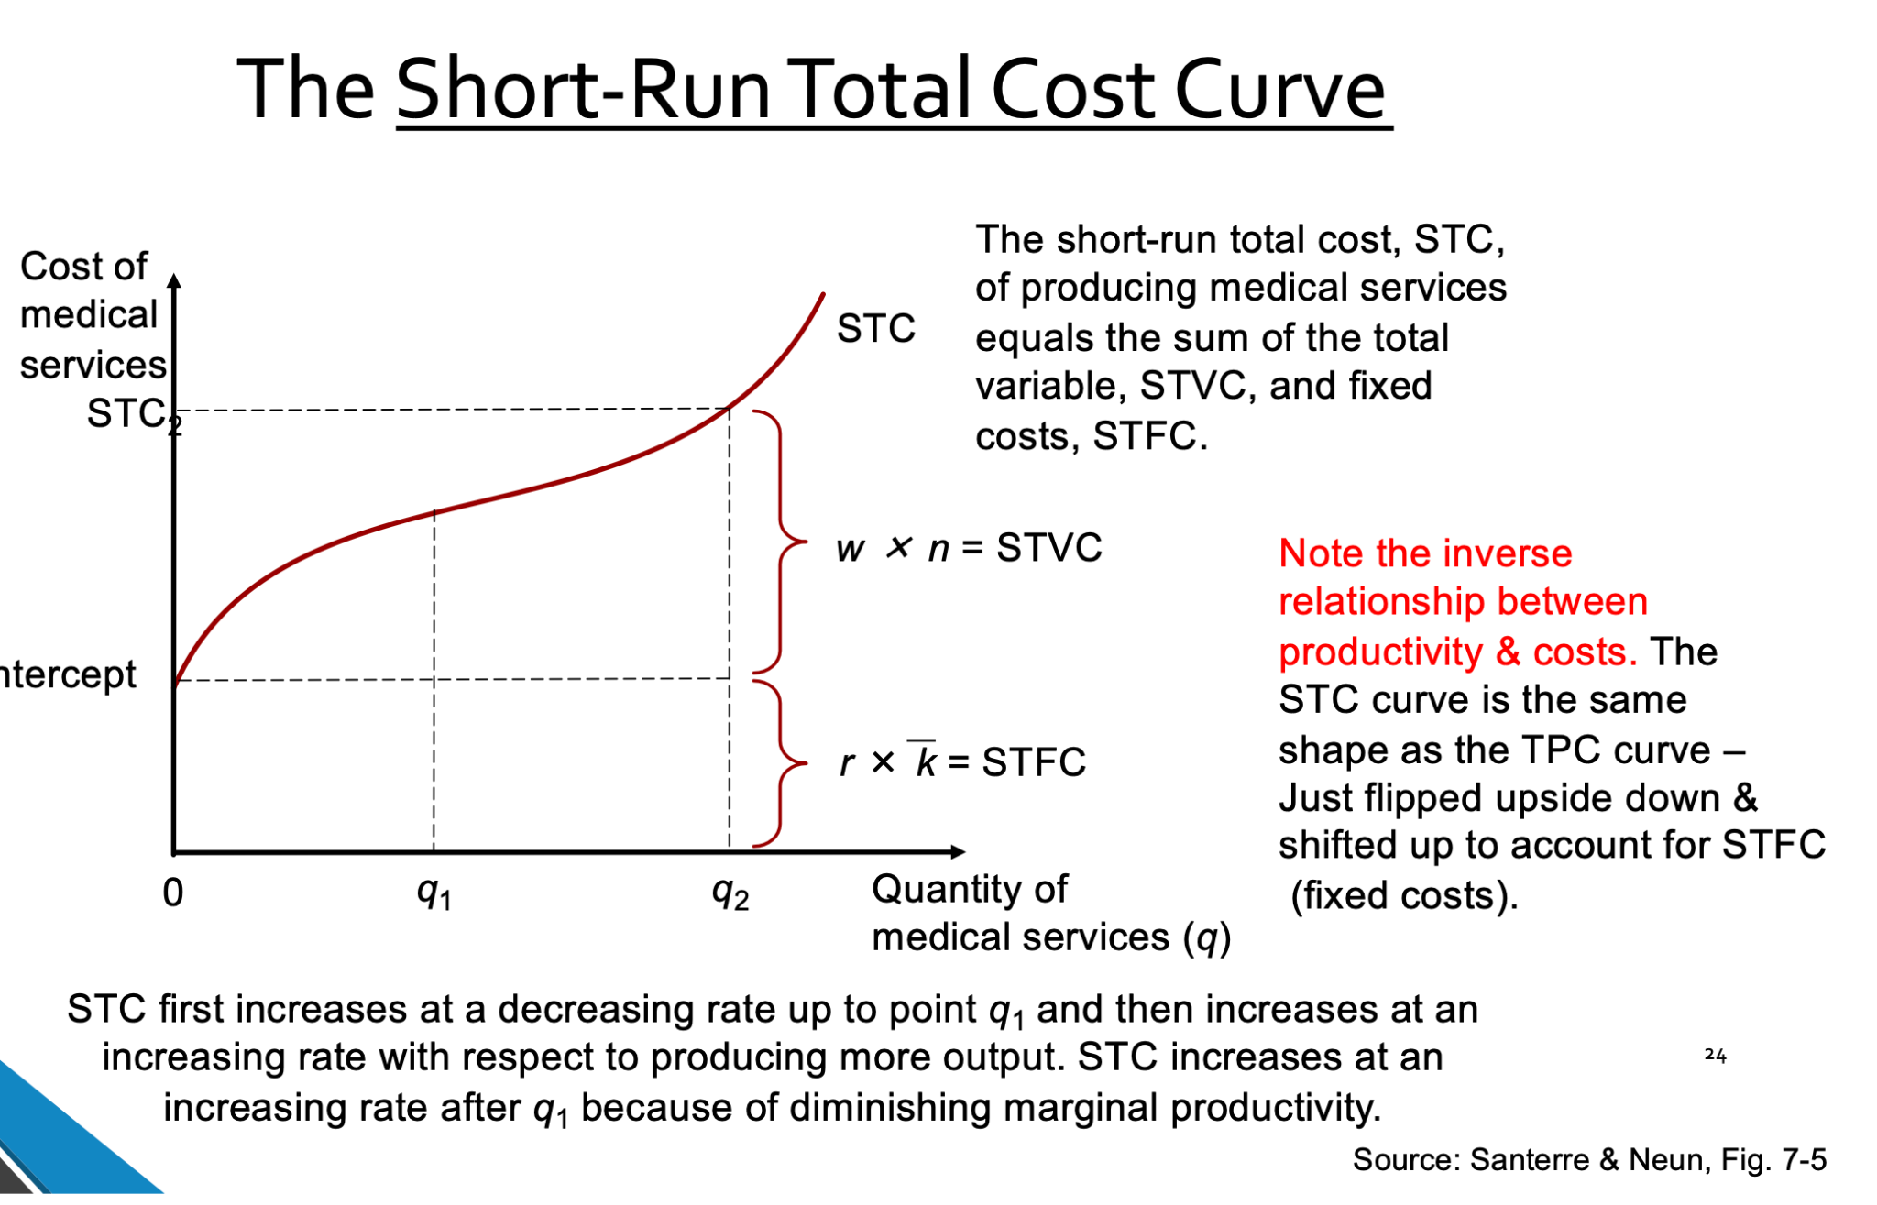

Slide 42
Relationship between TPC & STC
Relationship between STC and TP
• When TP is increasing at an increasing rate
• STC – increasing at a decreasing rate
• When TP increasing at a decreasing rate
22• STC - increasing at an increasing rate

Slide 43
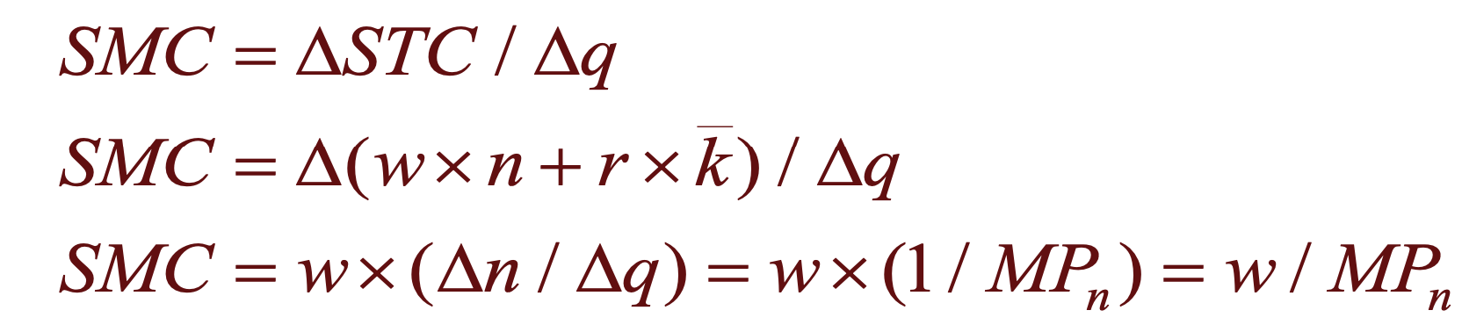
Short Run Per unit Cost of Production
Short-run MARGINAL costs:
SMC = Change in total costs associated with a one-unit change in output
Notes:
Note inverse relationship between SMC and MPn
and direct relationship between SMC and w
An example: If bringing on one additional worker at $20/hr results in
an increase in output of 5 units (Marginal Productivity).
The SMC is $20/5 = $4.

Slide 44
